Slide 1

Gem management with Bundler

Slide 2
Hi, Rails Girls
I’m
Jeffrey Lee
These slides are hosted at
http://jeffreylee.org/railsgirls

Slide 3
Gems
Code · Documentation · Tests

Slide 4

Code
Gems are packaged, distributable bits of code.

Slide 5
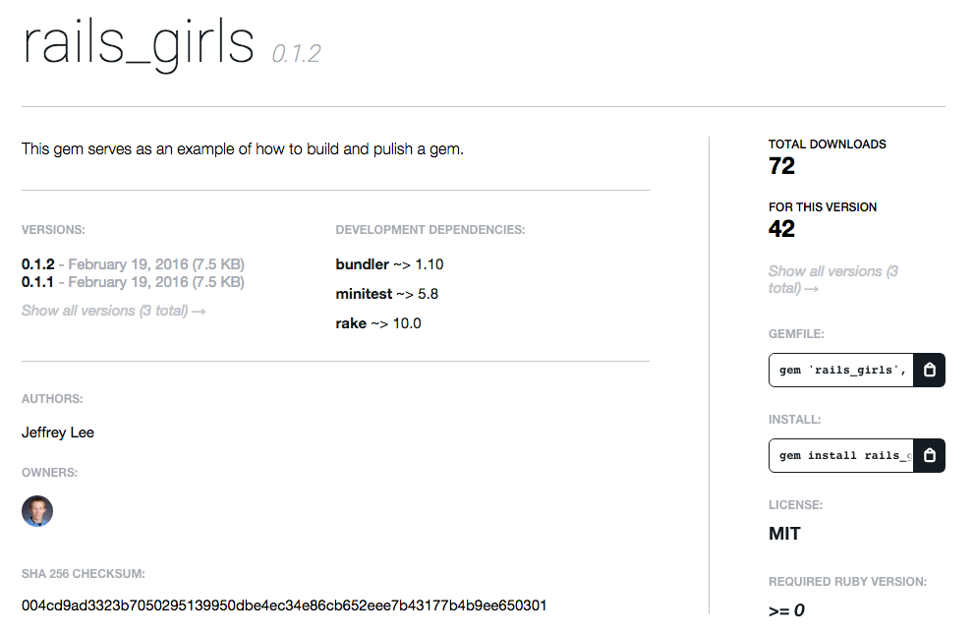
Documentation

Slide 6

Tests
Ensuring your code works

Slide 7
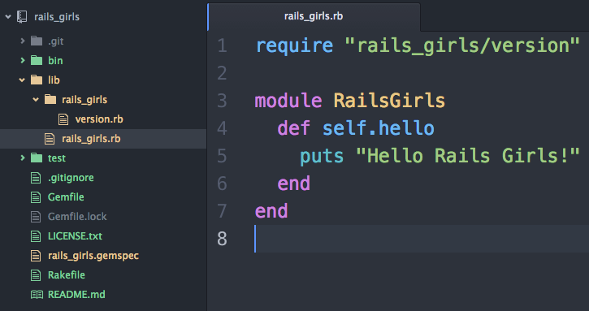
An Example Gem

Slide 8
Bundler
A Package Manager for Ruby

Slide 9
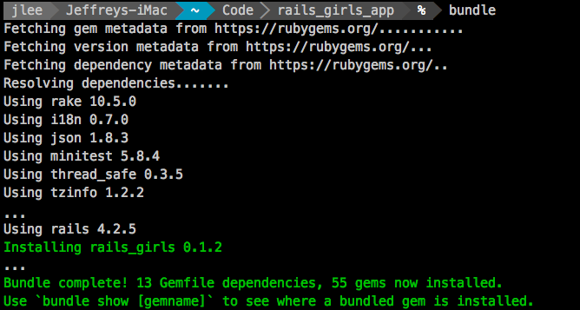
bundle

